Slide 1

Helping users navigate data specifications
Data specification navigator
Quoc Anh Nguyen

Slide 2


Slide 3
Motivation – the problem
Users want data but don’t know SPARQL or the domain very well.
They rely on a human expert.
This creates a bottleneck in organizations.

Slide 4
Goals
Map natural-language questions to items in data specification with the help of LLM.
Generates SPARQL queries.
Suggest related items to refine queries with the help of LLM.

Slide 5
Dataspecer
Ongoing project at KSI.
Tool for management of semantic data specifications.

Slide 6
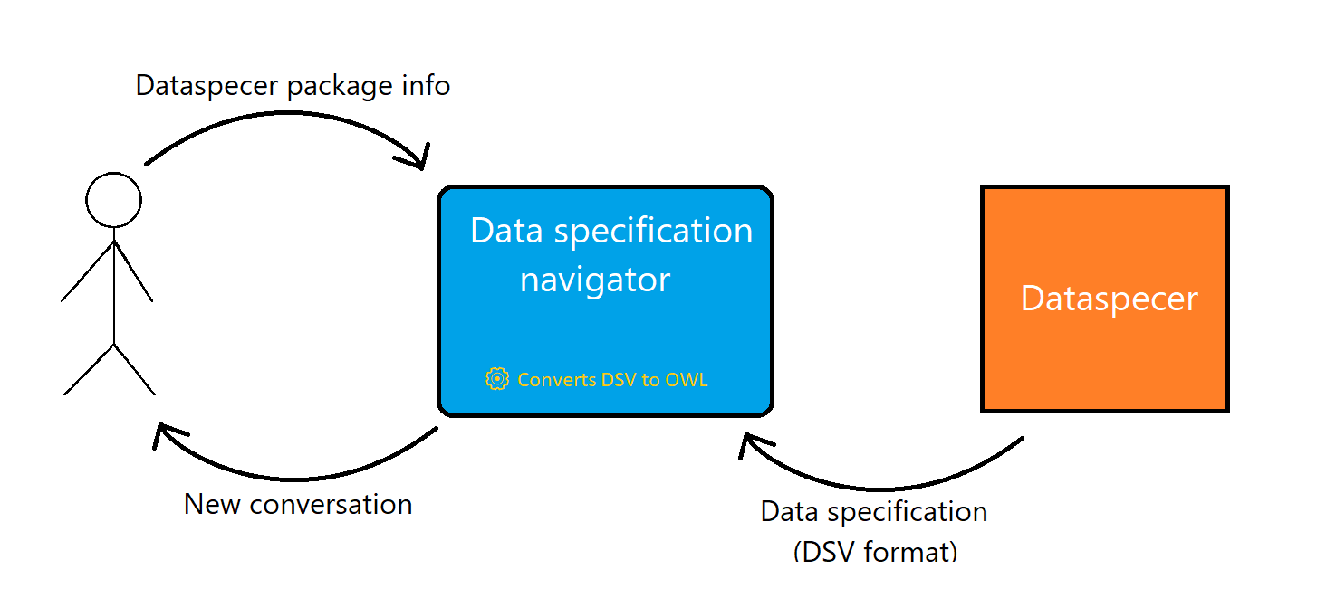
Input and output

Slide 7
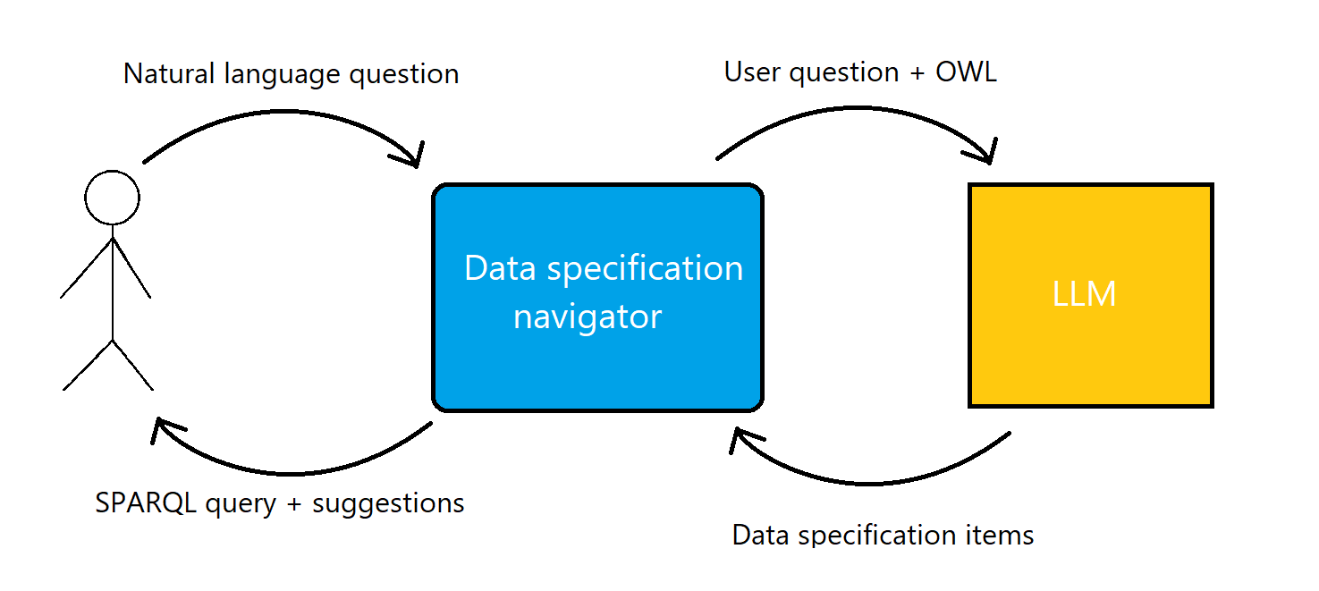
Input and output cont.

Slide 8
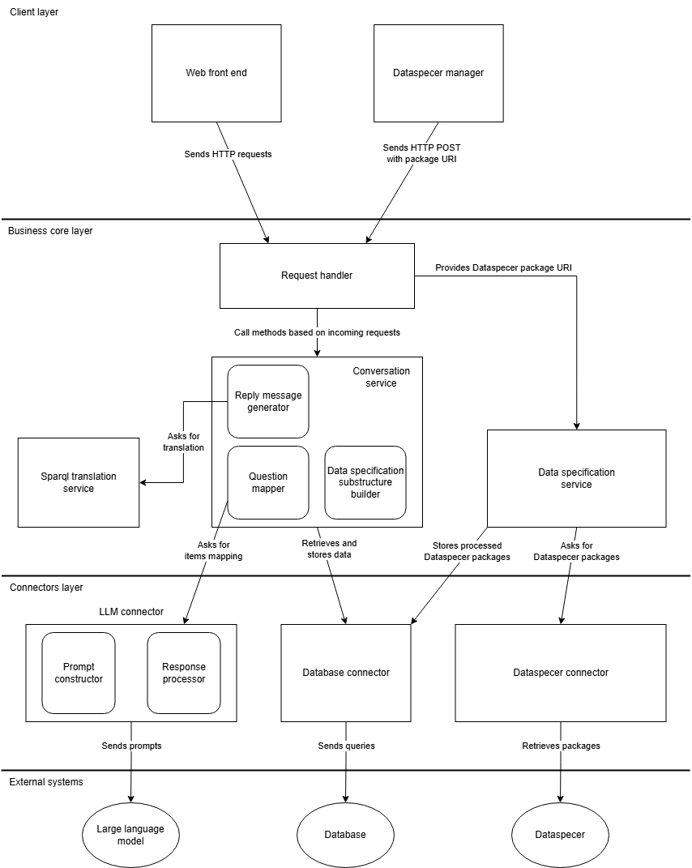
System Architecture

Slide 9





Technologies

Slide 10
Demo

Slide 11
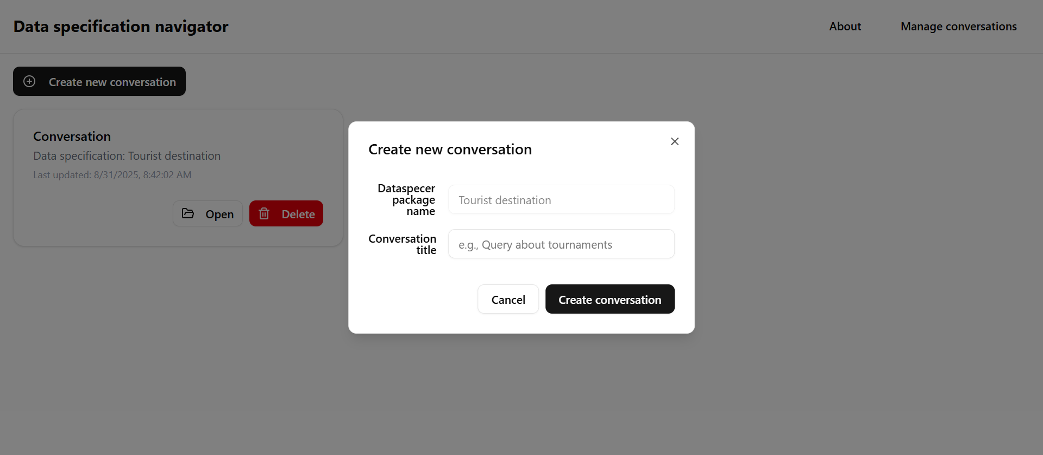

Slide 12

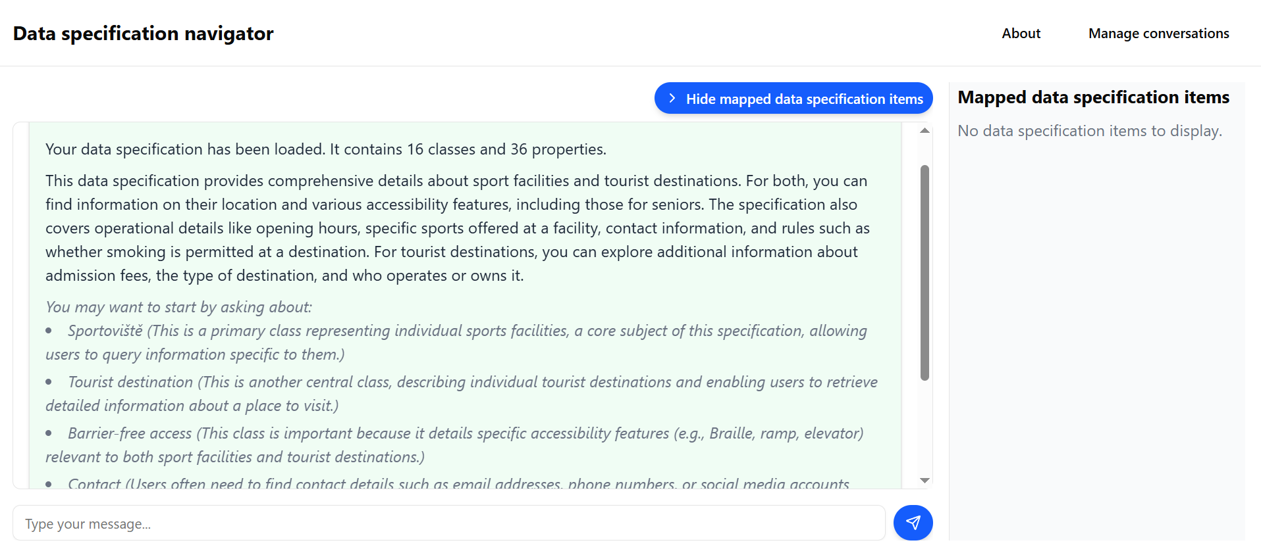

Slide 13
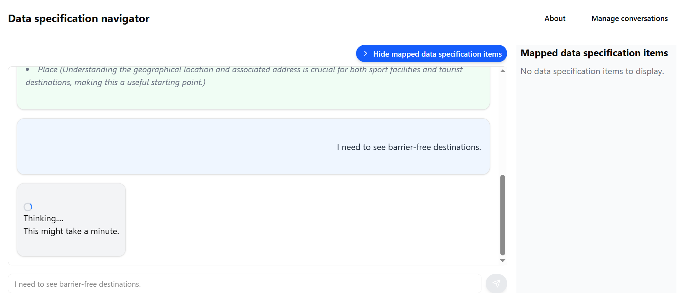

Slide 14
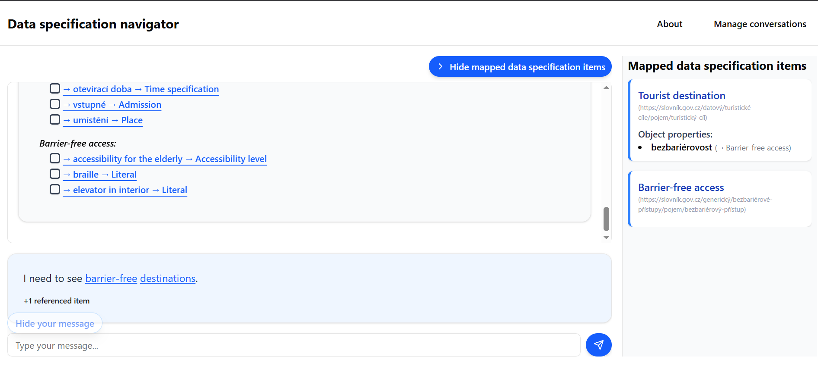

Slide 15
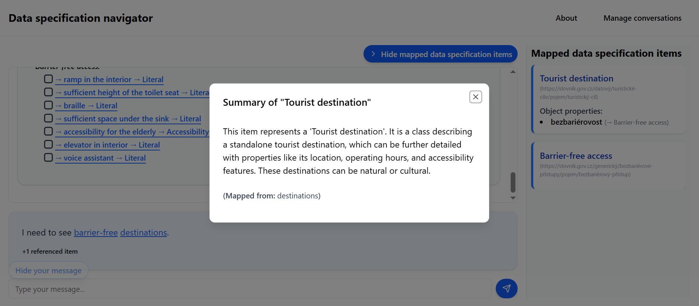

Slide 21
Successfully implemented
DSV to OWL conversion.
Mapping concepts from natural language to data specifications.
SPARQL generation.
Suggestions for natural-language question.
Foundation for future extension and research.

Slide 22
